Slide 1
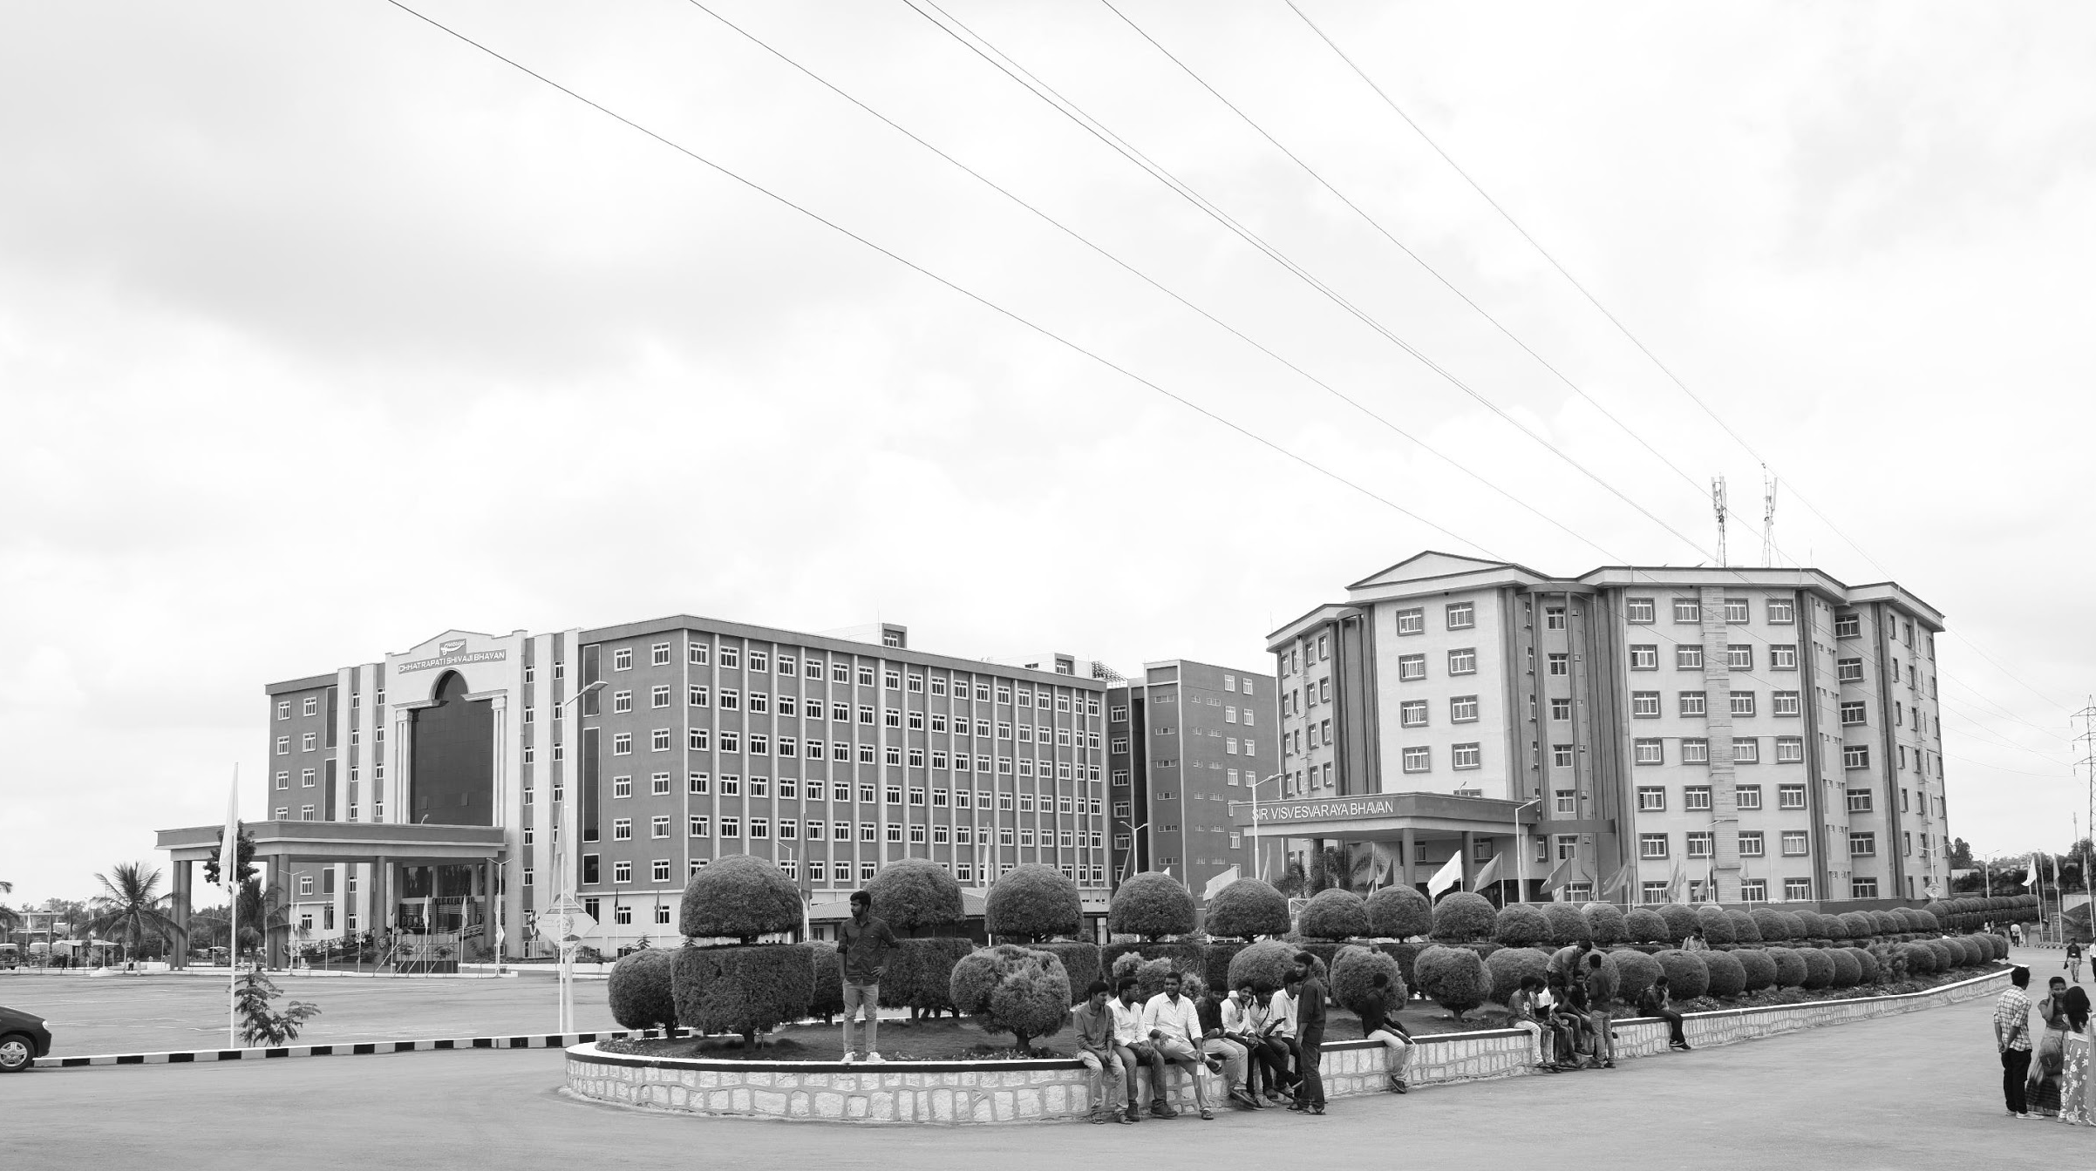

Design and Development of Self-Heating and Cooling Materials in Wiring Harnesses
AY 2021-25
GITAM UNIVERSITY
Major Project
Project ID: C4
A University should be a place of light, of liberty, and of learning.
Department of Electrical Electronics and Communication Engineering
Project Mentor:
Dr. C. Kamalanathan
Associate Professor/EECE
Project Team:-
G. Narendra – BU21EECE0100166
Kula Shekhar Reddy – BU21EECE0100384
K. Sai Jeevan – BU21EECE0100202
www.gitamedu.com

Slide 2




Project Group – Details
Photo
Track
Roll No
Name
EECE
BU21EECE0100166
Gali. Narendra
Photo
EECE
BU21EECE0100202
K. Sai Jeevan
Photo
EECE
BU21EECE0100384
G. Kula Shekhar Reddy

Slide 3
Objective and Goals
Objective
To identify the self-heating and cooling materials for wiring harnesses
To enhance the safety, reliability, and efficiency of electrical systems.
To optimize the power consumption in the proposed system.
Goals
Enhance Safety: Develop materials that regulate temperature to prevent overheating, electrical failures, and fires in wiring harnesses.
Improve Reliability: Increase electrical systems' durability and consistent performance by protecting wiring harnesses from environmental damage.
Boost Efficiency: Optimize energy use and reduce maintenance needs through advanced self-heating and cooling materials.
Innovate Material Design: Create and integrate new materials that set a new standard for temperature control in wiring harnesses.
Safety: Material to avoid overheating and over-cooling

Slide 4
Abstract
An organized system of wires, terminals, and connectors that run throughout the entire vehicle and transmit data and electrical power is known as a wiring harness. As a result, wiring harnesses are crucial in connecting many components. Wiring harnesses play a significant role in the growth and development of auto manufacturers all over the world.
The need for automotive wire harnesses is anticipated to rise as a result of more attention being paid to passenger safety, as well as an increase in the number of electric vehicles on the road globally and numerous other causes.
An innovative approach to managing temperature variations within wiring harnesses, particularly in automotive and aerospace applications. Traditional wiring harnesses encounter significant challenges related to temperature management, such as overheating and inadequate cooling, which can compromise performance and reliability.

Slide 5
Sl. No | Title | Author & Year | Methodology | Drawbacks | Link
1. | Approaches for automated wiring harness manufacturing: function integrating with additive manufacturing | 2023 Nico Lorenz and Ralph Mayer​ | → Additive manufacturing → Electrical Conductive Polymers → Automation Technologies → Test and Measurement Technologies | → Lower Electrical Conductivity → Cost Concerns → Mechanical and Durability Challenges → Technologies Readiness | https://link.springer.com/article/10.1007/s41104-023-00137-9
2. | High-Strength Aluminum Wires for Low-Voltage Automotive Engine Wiring Harnesses | 2017 Kinji Taguchi Takanobu Shimada Jun Shimada Tetsuya kuwabara Yasuhiro Akasofu | →High-Strength Aluminum Alloy Development →Aging heat treatment →Crimping Technology →Wire Manufacturing Process | → Lower Electrical Conductivity → implementation costs → Compatibility with existing components | https://global-sei.com/technology/tr/bn84/pdf/84-22.pdf

Slide 6
Sl. No | Title | Author & Year | Methodology | Drawbacks | Link
3. | Development and validation of a material application tool for the covering process of a wire harness | 2020 Paul Heisler Erik hausecker Johannes regler Robert wolf Jorg franke | Liquid material application Fused deposition modeling Improved material testing | Challenges with wire alignment and bundling Inconsistent coating thickness Material curing time | A

Slide 7
Analysis - SWOT
Strengths
Weaknesses
Higher initial cost
Weight and size
Long-term durability
Enhanced safety
Improved reliability
Energy efficiency
Threats
Competition
Economic fluctuations
Opportunities
Growing demand for advanced electronics
Automotive market
Aerospace industry

Slide 8
Challenges currently facing
Heat and Thermal Management
Wiring harnesses are often exposed to high temperatures, especially in automotive or industrial applications. Excessive heat can cause insulation to degrade leading to short circuits, malfunction, or even fires
Impact: Reduced lifespan and reliability of the wiring harness, increased risk of electrical failures
Mechanical Stress and Vibration
Constant exposure to mechanical stress and vibration can lead to wear and tear on the wiring harness, resulting in broken wires and damaged connectors
Impact: Intermittent electrical connections, signal loss, and potential safety hazards

Slide 9
Complexity and size Constraints
As modern vehicles and machinery become more complex, the wiring harness must manage an increasing number of circuits and connections in a limited space
Impact: Difficulties in insulation, higher manufacturing costs, and increased potential for wiring errors.
Moisture and Corrosion
Exposure to moisture, humidity, or chemicals can cause corrosion of connectors and wires, leading to electrical failures
Impact: Increased maintenance costs, potential for electrical short circuits, and degraded performance

Slide 10
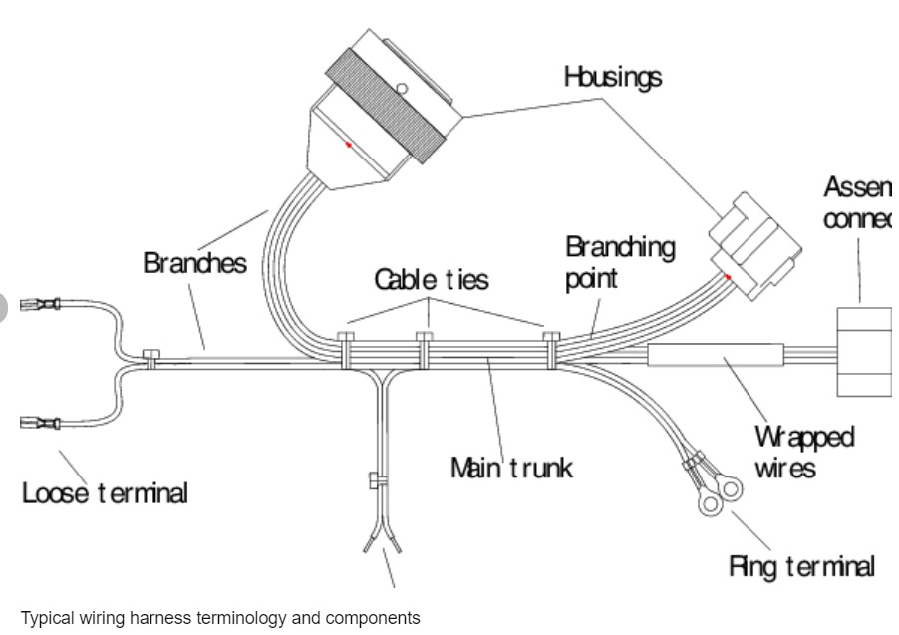
The structure of the wiring harness is divided into 6 steps
Step 1:Design and Planning
Schematic: A detailed diagram outlining the components, connections, and wire lengths

Slide 11
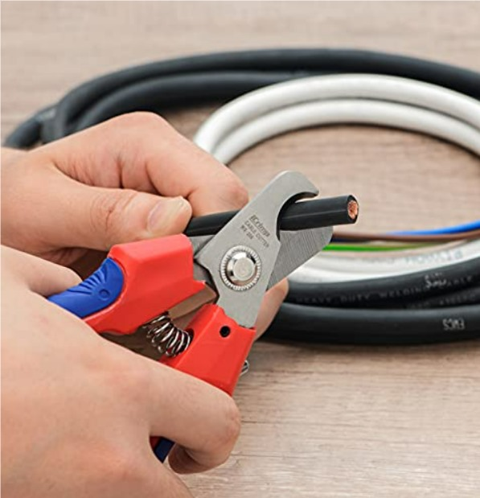
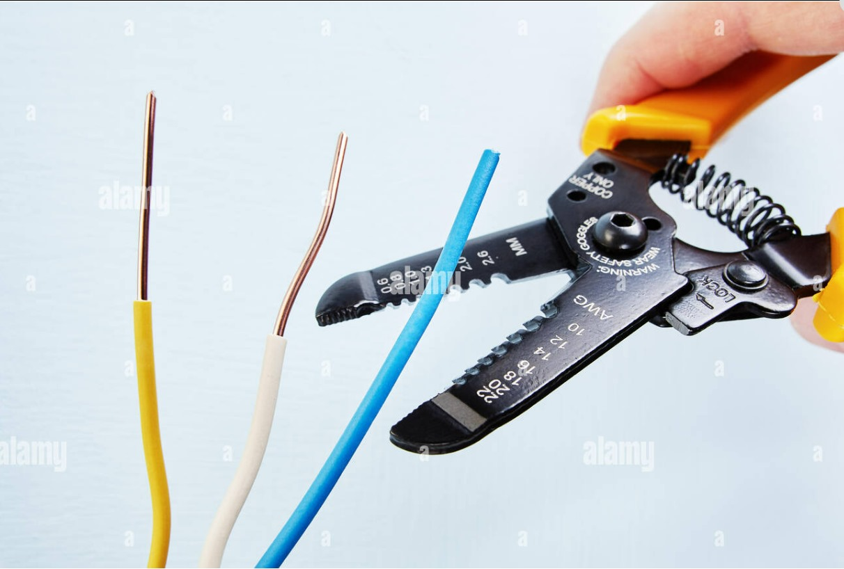
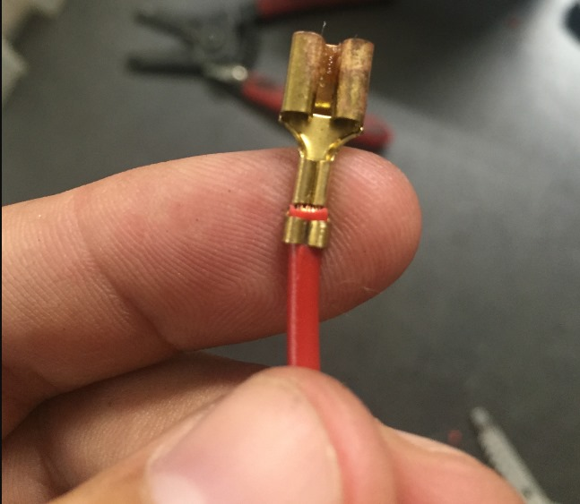
Step 2: Wire Preparation
Cutting: Wires are cut to precise Lengths using Wire cutters
Stripping: Insulation is removed from the wire ends
Crimping: Terminals or connectors are attached to the wire ends

Slide 12
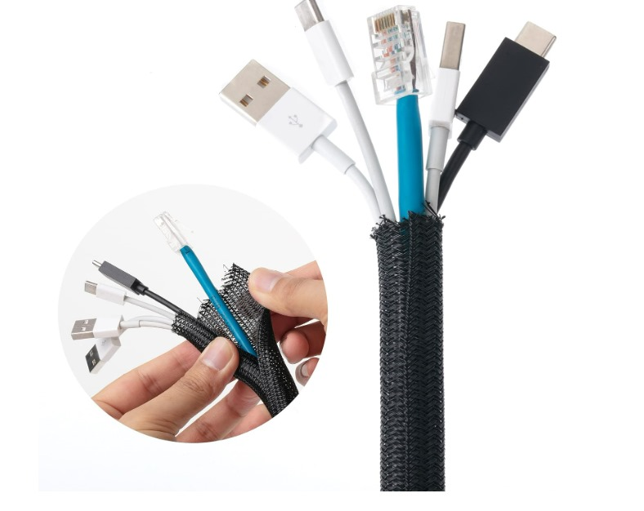
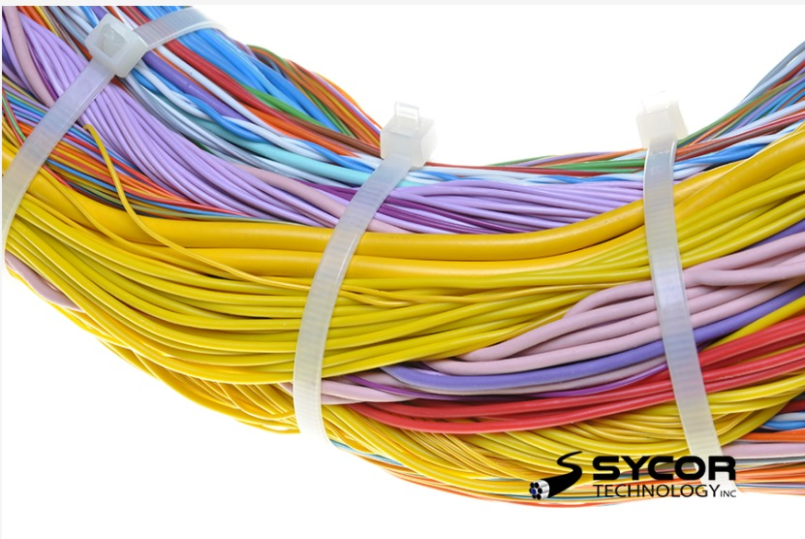
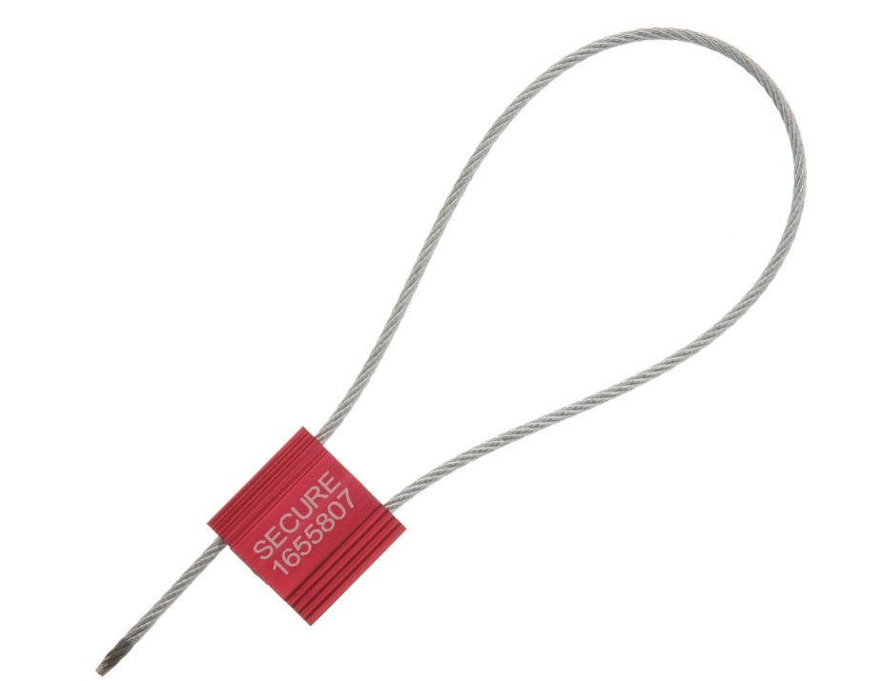
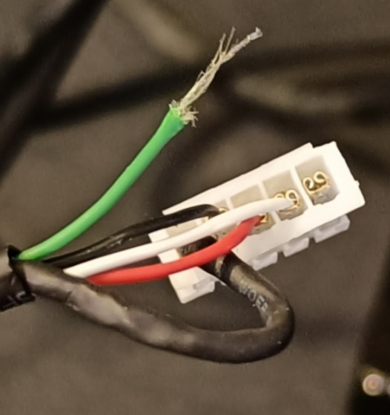
Step 3: Assembly
1. Bundling: Wires are grouped together
3.Sleeves: Protective sleeves may be added for shielding
2. Securing: Cables ties or straps are used to hold the wires together
Connectors: Connectors are attached to the prepared wires

Slide 13
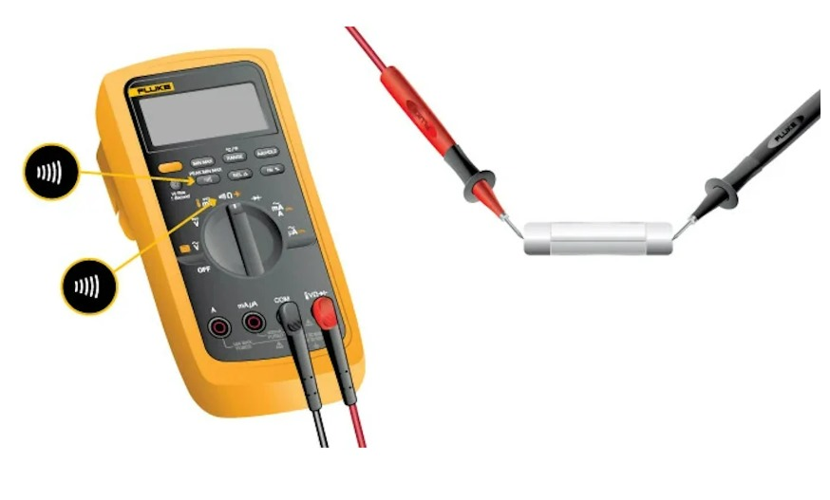
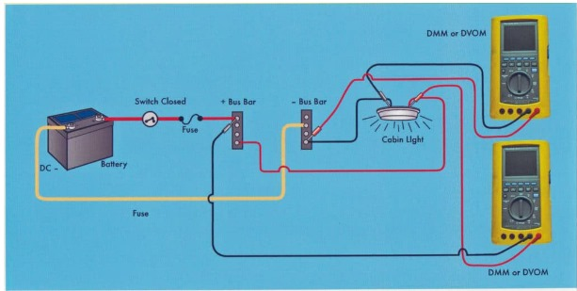
Step 4: Testing
Voltage Drop: Voltage drop is measured to ensure adequate power supply
Continuity: The continuity of each wire is checked
Functional: The entire harness is tested for proper operation

Slide 14
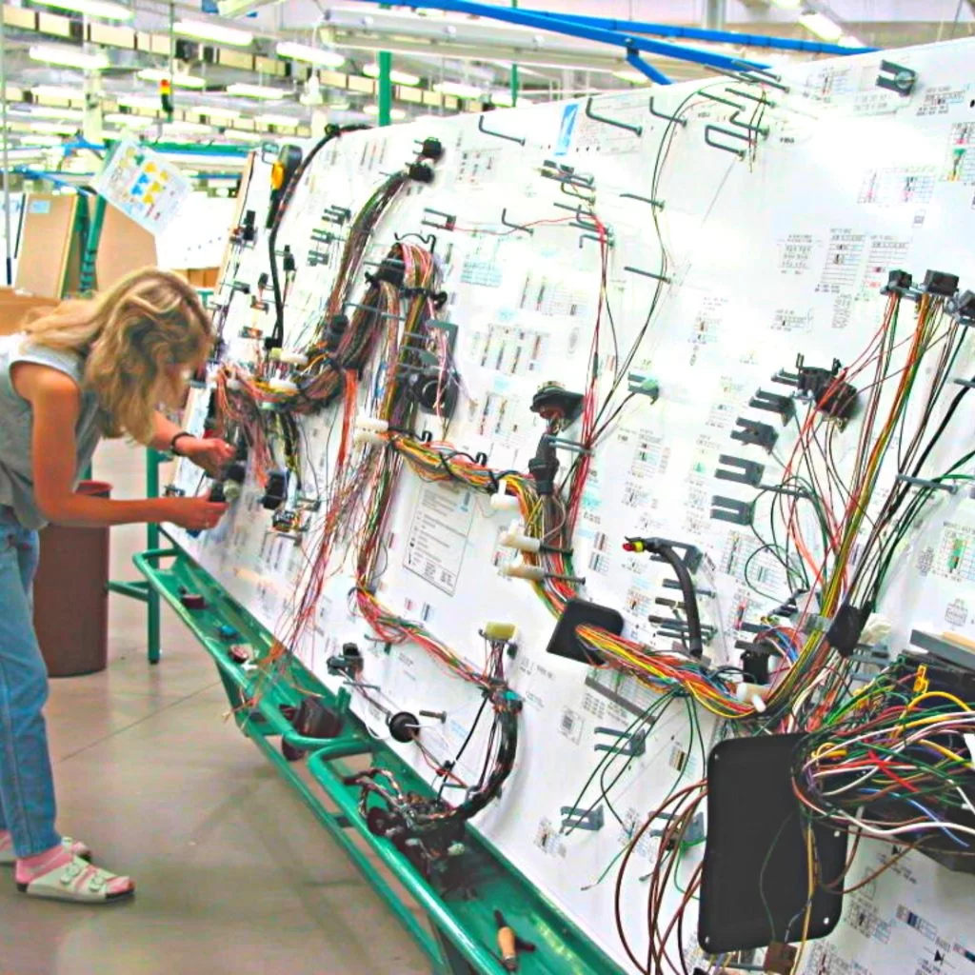
Step 5: Quality Control
Inspection: The harness is visually inspected for defects
Testing: Additional tests may be conducted, such as vibration or temperature testing

Slide 15
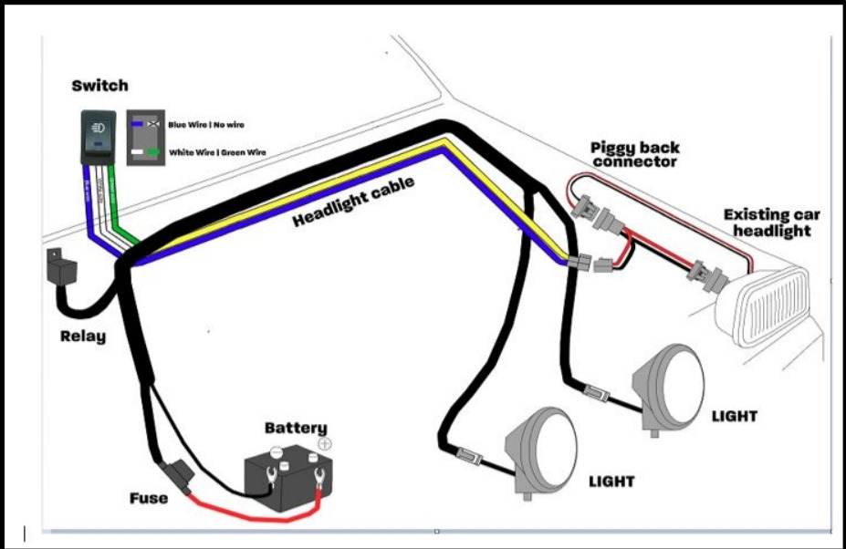
Step 6: Labelling
Identification: Wires or connections labeled for easy reference

Slide 16
Conclusion:
"The Design and Development of Self-Heating and Cooling Materials in Wiring Harness project addressed some challenges associated with traditional wiring harnesses. By integrating innovative self-heating and cooling materials, we want to develop a wiring harness system that regulates temperature and significantly enhances electrical systems' overall safety and reliability.
Our approach involved careful material selection, advanced thermal management techniques, and rigorous testing to ensure the harnesses' performance in diverse environmental conditions. The resulting self-regulating wiring harnesses demonstrated substantial improvements in preventing overheating, reducing the risk of electrical failures, and mitigating potential hazards such as short circuits and fires.
This technology has the potential to revolutionize various industries, including automotive, aerospace, and electronics. Future research could further optimize material properties, develop more efficient thermal management strategies, and explore new applications for self-regulating wiring harnesses."

Slide 17

THANK YOU

